Slide 1
Programming JAVA {
Hiveed.java
TypeCasting ;
/* Here is where your journey for your dream begins */
}
JAVA Programming

Slide 2
Hiveed.java
What is TypeCasting :
TypeCasting is the process of converting one non-primitive datatype into another non-primitive datatype.
TYPECASTING
Upcasting
Downcasting
JAVA Programming

Slide 3
Hiveed.java
Upcasting
Upcasting is the typecasting of a child object to a parent object.
Upcasting can be done implicitly.
Upcasting gives us the flexibility to access the parent class members but it is not possible to access all the child class members using this feature.
we can access the overridden methods. Advantage is Generalization of object.
SYNTAX :
Child c = new Child();
Parent p = new Child(): ;
JAVA Programming

Slide 4
Hiveed.java
Example :
ChildClass
ParentClass
non-Private-variables,methods
[ parent-class]
non-Private-variables
non-Private-methods
variables [ Child-class ,]
methods-[ child Class ]
Extends
ChildClass c=new ChildClass();
ParentClass p=new ChildClass();
JAVA Programming

Slide 5
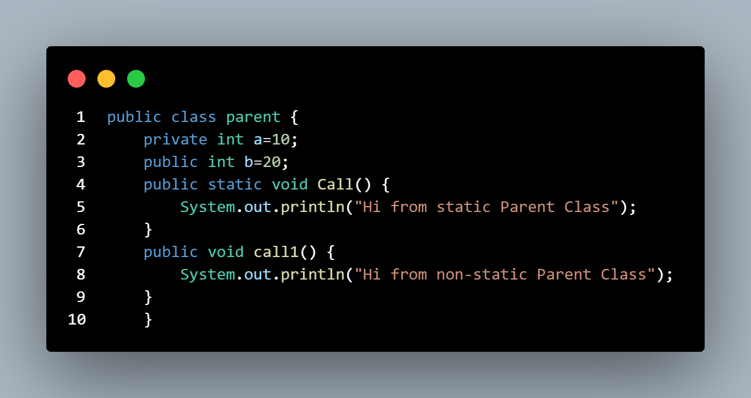
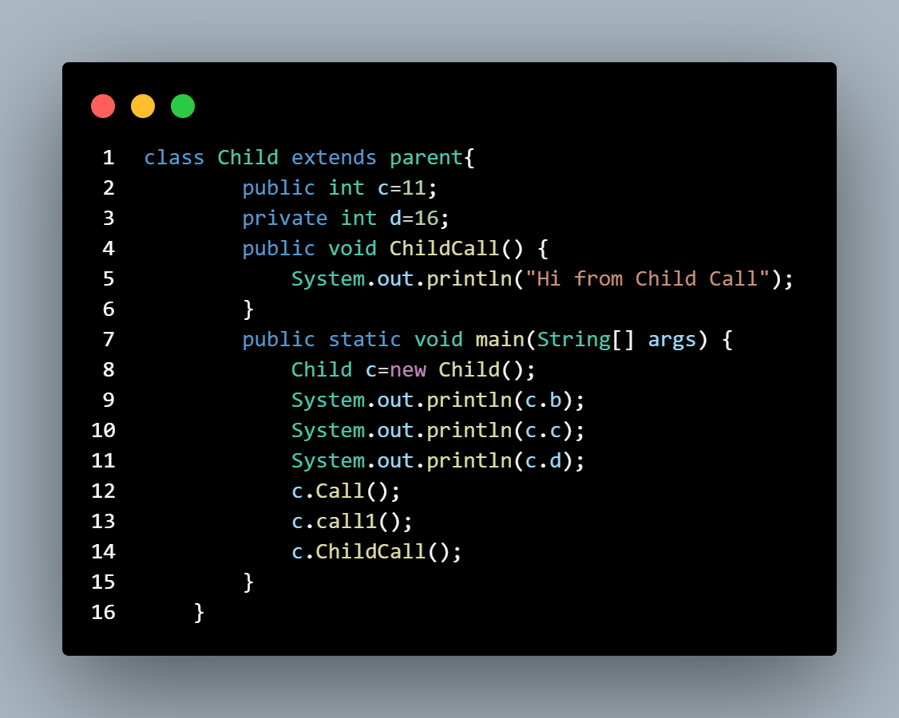
Hiveed.java
JAVA Programming

Slide 6
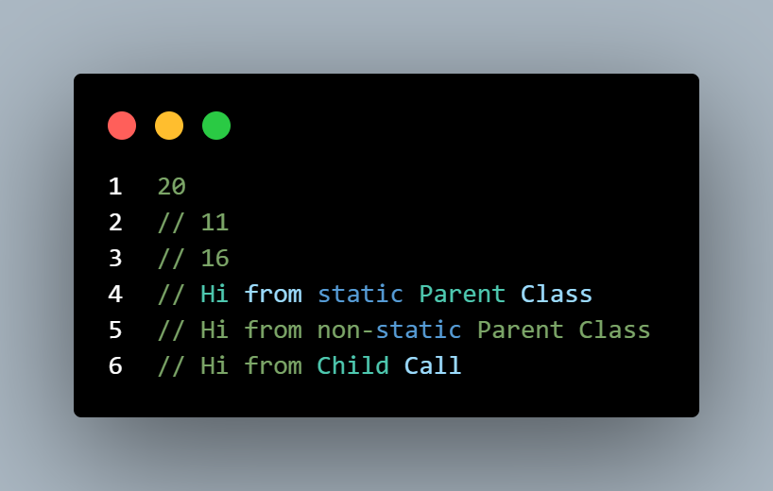
Hiveed.java
OUTPUT :
JAVA Programming

Slide 7
Hiveed.java
Downcasting :
Downcasting is the process of storing parenttype object into the childtype reference type is known the downcasting.
Downcasting done explicitly.
Syntax :
ChildClass c=new ParentClass();
ClassCastException error
JAVA Programming

Slide 8
Hiveed.java
ClassCastException :
ClassCastException is the complie time error inordert to avoid this programmer must to do typecasting it.
Syntax :
Child c=new Child();
Parent p=(Parent)c;
JAVA Programming

Slide 9
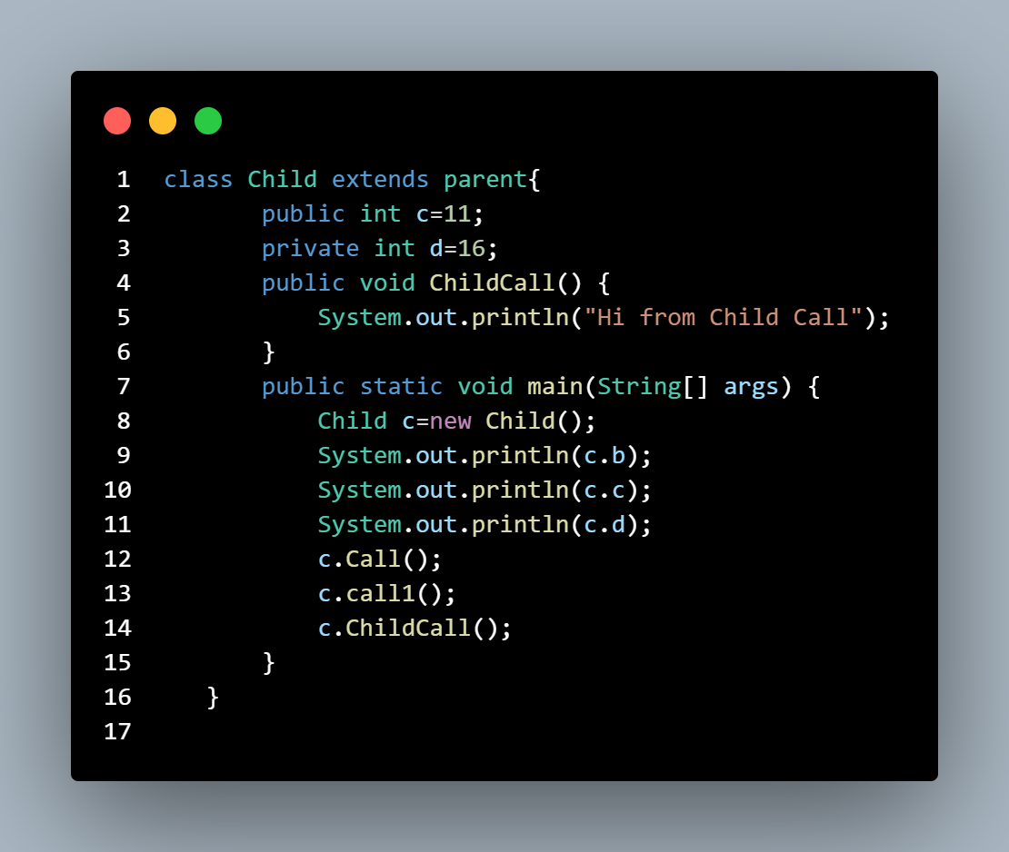
Hiveed.java
JAVA Programming

Slide 10
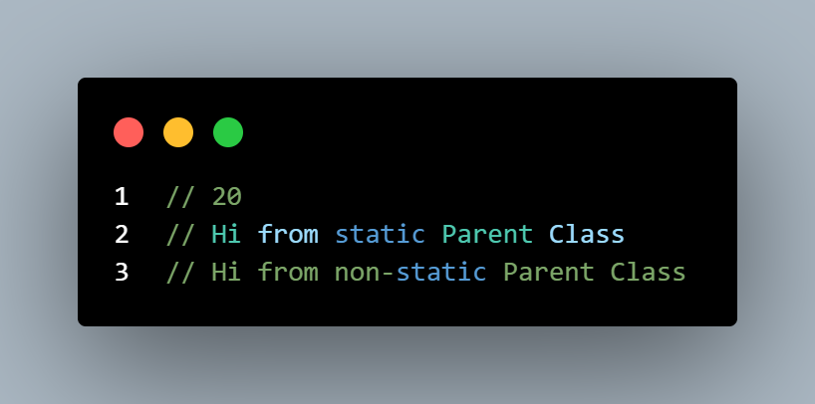
Hiveed.java
Output :
JAVA Programming

Slide 11
Hiveed.java
This Keyword:
‘this’ is a reference variable that refers to the current object, or can be said “this” in Java is a keyword that refers to the current object instance.
JAVA Programming

